Slide 1



Student Buddy
答辩人：方光贤

Slide 2
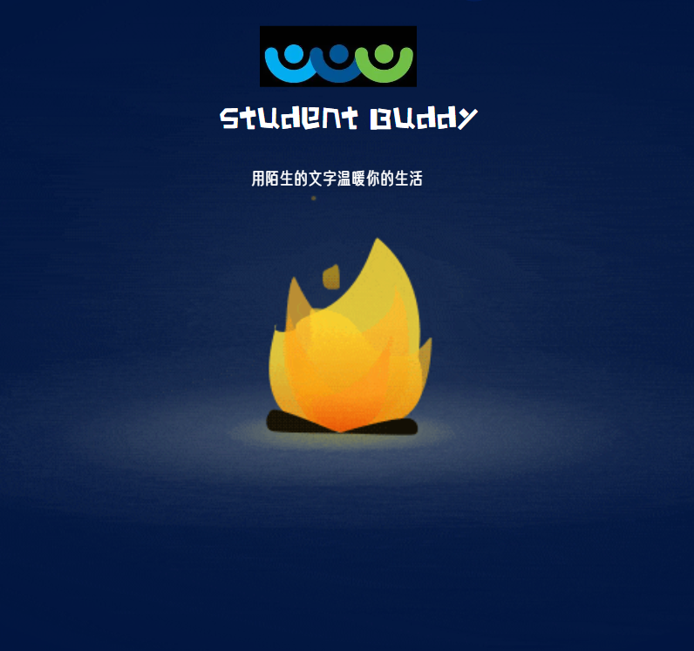
Catalog
1
Achieve
2
Result display
3
Design process
4
Group members work assignment

Slide 3

Part1
Achieve

Slide 4

Project background and significance
Achieve
1.Prototype interface matches the requirements
2.Provides a good user experience
3.It is easy to operate
4.It has an attractive design

Slide 5
Part2
Result display

Slide 6
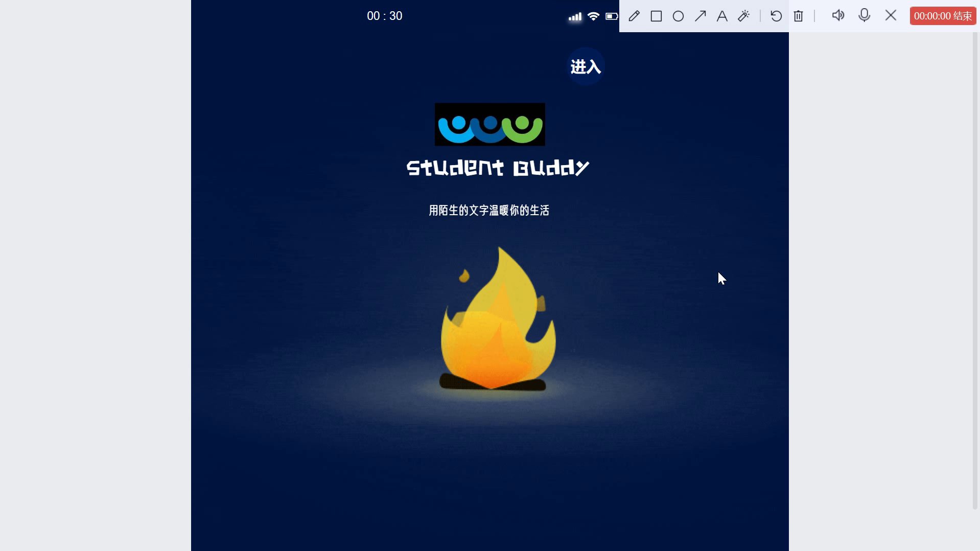
Result display

Slide 7
Part3
Design process

Slide 8

Prototype Design
We use Mockplus for prototype design. It is a very excellent prototype and interaction design software. Its core advantage is that when it is necessary to show the interface jump logic and deduce the operation process, a considerable degree of fidelity prototype can be made clearly and quickly for the team to play with, and it has collaborative function and compatibility.

Slide 9




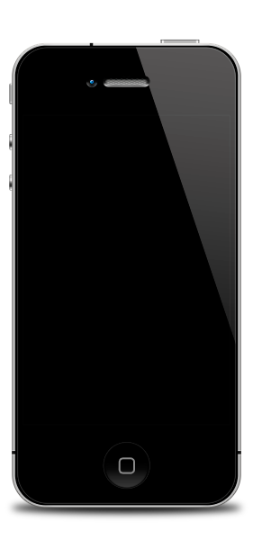

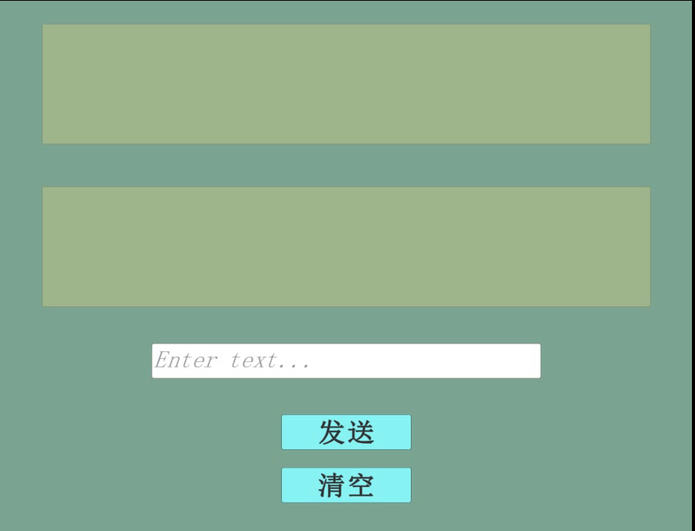

The non-functional requirements
1. Demand analysis:
This is to make relevant functions and corresponding page design that meet the requirements when designing our software, and this task has been completed in the fourth assignment.
2.Look for materials
Prototype design is the first impression of the viewer to contact the web page, so its design style should be consistent with the overall page, the color collocation should conform to people’s visual habits, and coordinate with the overall tone of the page. Look for suitable materials for our software is important.
3. Prototype design
It is a platform for visitors to communicate with the web page, because it has a special position in the web page, so its design should follow certain principles. The first is simplicity, simplicity is to facilitate users to use, understand the content of the web page. The second is clear security, which refers to the information that intervenes in the system when the user makes a dangerous choice. Finally, it is flexible and user-friendly, which means that users can use it easily and quickly.
4.Test
This is to make the page design more popular, can better enhance the user experience. Our team first used the interface, and collected opinions for optimization, and strive to complete a better design.

Slide 10
Part4
Group members work assignment

Slide 11
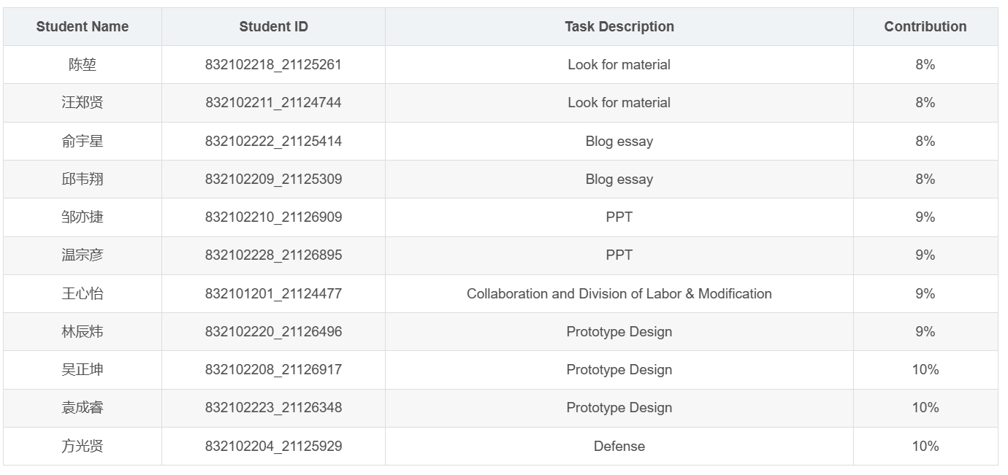
Group members work assignment

Slide 12
谢谢观看

